Slide 1

Watchalot Data Report
Study of Prevailing Trends in Media Genres for Streaming

Slide 2
Table of Contents
Business Task
Data Context
Genre Composition
Highest Ratings
Highest Votes
Highest of Both
Contrast of Ratings and Votes
Data Analysis and Conclusion
Business Strategy and Recommendations
Conclusion and Q&A

Slide 3
Business Task
The Streaming Service Watchalot has requested to gather information for their catalogue to find the most watched and popular shows they can include
The goal is to
Find out which media is the most popular and abundant
Which media has the highest views and ratings
What genres are the most popular in this range
Are there any niches that have yet to be filled
We will present our findings and data to apply recommendations based on the trends discovered.

Slide 4
Data Context
We will look at Netflix, the most successful streaming service as our source of data. Netflix does not publicize its data reports so we rely on an IMDB or The Internet Movie Data Base to get our information.
This dataset contains movies and tv from 2023’s Netflix lineup and contains crucial aspects such as the medias name, genre, number of votes, and the ratings.
We can use this to get a good idea of the popularity of the media included in Netflix’s catalogue by correlating the number of votes to people who have watched it. We use 10,000 or over votes as the baseline for a popular movie and a 7 average for a high rating.

Slide 5
Genre Composition
The dataset has defined nineteen different genres that that all the media are included as. These genres are Action, Adventure, Animation, Biography, Crime, Comedy, Drama, Documentary, Fantasy, History, Horror, Music, Mystery, Sci-Fi, Sport, Romance, Thriller, War, and Western.
We counted all the movies listed in each
individual genre and charted it. You can
See Comedy and Drama have the highest
amount. Followed roughly with Action,
Adventure, Crime, Romance, and Thriller.
Sci-Fi, Sport, Biography, War, and especially
Western have significantly low numbers.

Slide 6
Highest Ratings
Here we compiled the media that have achieved a rating of 7 or higher in the dataset by
Their corresponding genre. We use a stacked column chart where the new values are stacked above the column to better see the proportions.
The stacked column chart does show significant
Proportions of the high rated media compared to
The overall total. We need to understand the base
Number of high ratings to the corresponding genre.
However it is better seen with a specific proportion
chart.

Slide 7
Highest Ratings Cont.
Here we can see the proportions of higher
Ratings to the total. We can see that Animation,
Biography, Documentary, Sport, and War have
Very high rating percentages. However Horror has
By far the lowest rating proportion.
However we must remember that by the totals these
Genres have significantly low total amounts in the
Dataset that affect the overall proportion. But these do show that generally these genres have
Higher ratings than usual. Drama, Adventure, and Crime do have generally good proportions
By their totals.

Slide 8
Highest Votes
Next we need to compare the high number of votes to the total. We are checking for media
That have over 10,000 votes meaning that plenty of
People have watched it. With this stacked column we
Can better portray this compared to the total amount
In the dataset.
If we look closely we can see a few notable changes
Compared to the rating chart but its better if we show
This through another proportion chart.

Slide 9
Highest Votes cont.
With chart the percentages become more apparent and surprising. We can obviously see that Sci Fi surpasses the other genres in votes by total close to Action, Adventure, Crime, Drama, Fantasy, Horror, Mystery, and Western.
We also see large downward percentages in the
Animation, Music, Sport, and Documentary to
Indicate that those genres are significantly less
Viewed and popular. Which is important to consider
How to balance high rated genres and high voted
genres.

Slide 10
Highest of Both
Since we know the genres with the highest ratings and the genres with the highest votes, we need to find which genres have the best amount of both. So now we check for the amount of media in each genre that has over 10,000 votes and a rating of 7 or over.
We can see a significant dip in many of the genres, with some being very hard to spot any
of the given criteria. The larger totals have the most
Visible bars which indicate some significant proportions.
But with it we need to see the percentages from the
Genre total.

Slide 11
Highest of Both Cont.
With the percentages we see a significant drop with none below 25%.
We see that Biograph, Western, Sci-Fi, Mystery, Crime, History, Drama, Action, and Adventure have a significantly higher percent when viewed in both high ratings and votes.
We also see dips in genres like Comedy, Horror, Mystery, Music, and Romance.
Its also important to keep in mind this is based off the total amount of media in the data, which should not indicate which genres are truly popular or not. For example Biography has a very small sample pool for its large percentage.

Slide 12
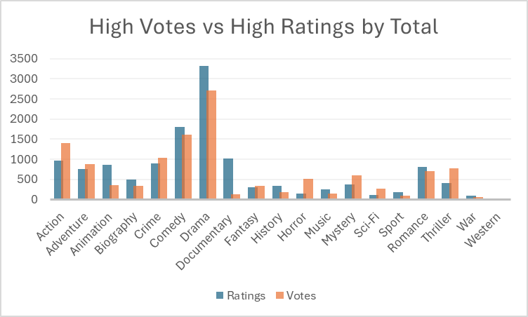
Contrast of Ratings and Votes
We need to compare the percentages of votes, ratings, and both from all genres so we gathered the percentages to a new chart to make contrast more apparent.
We see how much Documentary and Animation has a high rating but miniscule votes, how high Sci Fi, and Horror votes are to its ratings, and how Adventure, Crime, Drama, Fantasy, and Romance have relatively the same proportions.
But we should also compare the contrast by percentages to make the best conclusion.

Slide 13
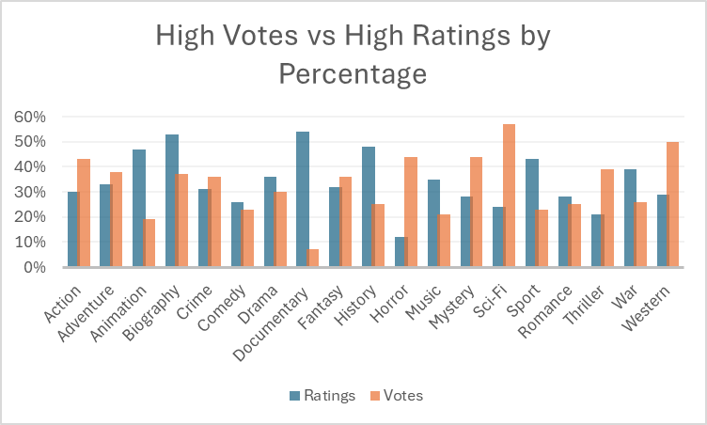
Contrast of Ratings and Votes Cont.
Now we can see the percentages of both Votes and Ratings.
This chart more actively shows the bigger comparison that by totals. Animation, Documentary, History, Sport, and War ratings are much higher, and Horror, Mystery, Sci Fi, Thriller, and Western have much higher votes.
With our data visualize lets make one last chart to finalize the data gathered between genres. This is to simplify the data from all genres.

Slide 14
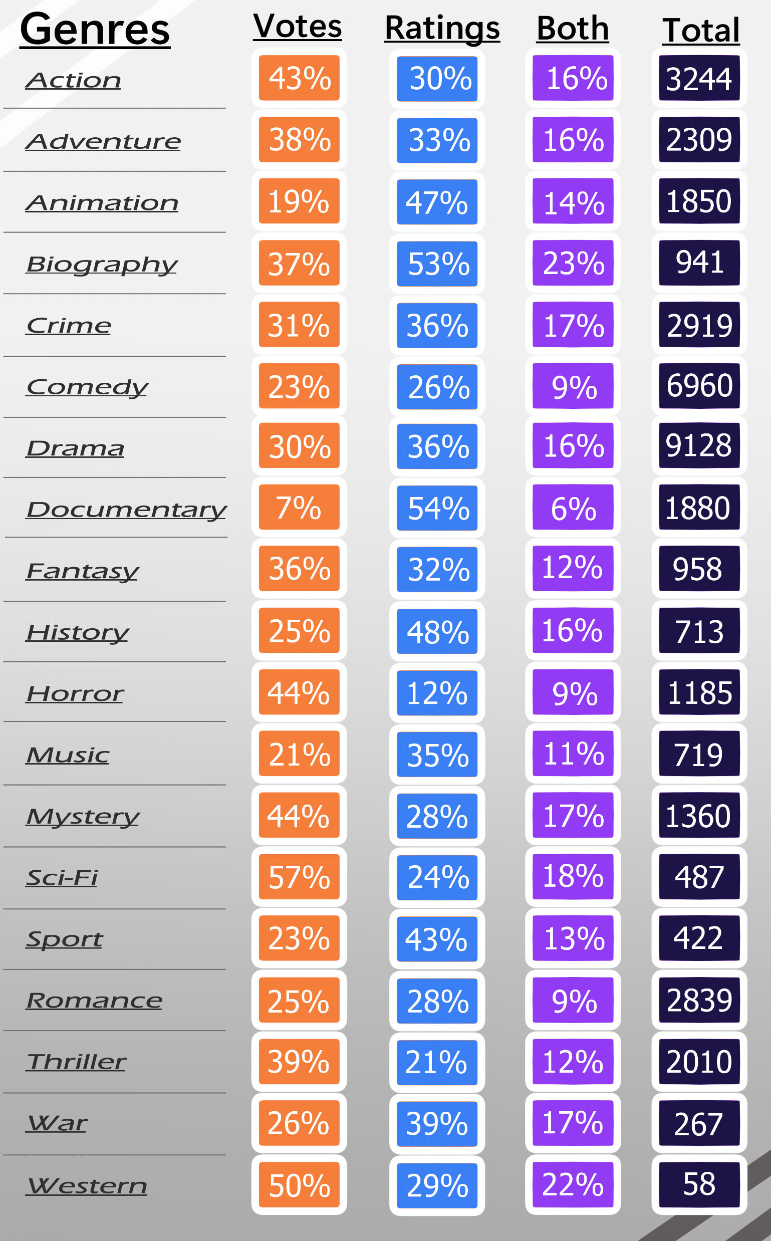
Data Analysis and Conclusion
We visualize the percentages of our values to best compare the findings between genres.
Action has high votes and decent ratings, with good amounts of both with a high total in the database.
Adventure has high votes and decent ratings with good amounts of both with a high total in the database.
Animation has low votes but high ratings with decent amounts of both with good total in the database.
Biography has high votes but very high ratings with high amounts of both but a low total.
Crime has decent votes and decent ratings, good amounts of both and a high total in the database.
Comedy has low votes and low ratings with low amounts of votes but extremely high totals.

Slide 15
Data Analysis and Conclusion cont.
Drama has decent votes and decent ratings with a good amount of both with extraordinarily high totals.
Documentary has very low votes but very high ratings with very low amounts of both and has good totals.
Fantasy has high votes and decent ratings with decent amounts of both and has low totals.
History has low votes but high ratings with decent amounts of both and low totals.
Horror has high votes but very low ratings with low amounts of both and lower totals.
Music has low ratings but decent votes with low amounts of both and low totals.
Sci-Fi has very high votes but low ratings and high amounts of both, with very low totals.

Slide 16
Data Analysis and Conclusion cont.
Sport has low votes but high ratings, with lower amounts of both with very low totals
Romance has low votes and low ratings with low amounts of both but high totals
Thrillers have high votes but low rating and decent levels of both with higher totals.
War has low votes but high ratings and high levels of both but very low totals
Westerns have high votes and low ratings but high levels of both. But has extraordinarily low totals.

Slide 17
Data Analysis and Conclusion cont.
What we have gathered is by genre the highest voted shows are Action, Adventure, Biography, Fantasy, Horror, Mystery, Sci-Fi, and Thriller.
By genre the highest ratings are Animation, Biography, Documentary, History, Sport, and War.
The genres with the highest levels of both are Biography, Sci-Fi, Crime, Mystery, War, Action, Adventure, Drama and History
The genres that have the biggest totals are Drama, Comedy, Action, Crime, Comedy and Romance.
War and Western have the fewest totals of all.
With all the data shown and explained we must make business recommendations.

Slide 18
Business Strategy and Recommendations
To prioritize views, the best option would be to invest in genres with high votes, meaning that Action, Adventure, Biography, Fantasy, Horror, Mystery, Sci-Fi, and Thriller could be the best options for viewing priority. Drama might be a good genre to invest in as well by its high volume in the database.
If we need higher rating shows for better acclaim, Biography, Documentary, and History have shown to have higher average ratings but usually less views.
For a balance of high views and high ratings, Biography, Sci-Fi, Crime, Mystery, War, Action, Adventure, Drama and History are recommended as well rounded genres to invest in accusations or production.

Slide 19
Business Strategy and Recommendations cont.
However it is important to also understand the totals in proportion to the findings
Animation has low views despite it totals by its appeal to a younger demographic making it hard to invest it. It is recommended to include but not to focus on.
War and Western have very few totals potentially making them too niche of a genre to safely invest in.
Comedy, Documentary, and Romance have a low amount of both high votes and ratings making it difficult to make a balanced investment in.
For niches that could be invested in more, Horror and Sci-Fi, and to a lesser extent Fantasy and Sports, have high values in views that have lower totals and could be a great opportunity to invest in to dominate the niche, by accusation or original production.

Slide 20
Conclusion and Q&A
With this this presentation is concluded with the suggested business strategies recommended to take to make Watchalot a streaming success.
If anyone has any questions, please do not be afraid to tell them and I will answer to the best of my abilities. If you need any contact information I will be free to give it out in case you have further questions after the presentation
If you need me to go back to a previous slide you can ask now.

